Slide 1


Slide 2

Time Management: Monitoring, Working Under Pressure, and Adhering to Deadlines

Slide 3

Introduction to Time Management
Time management involves organizing and planning how to divide your time across various activities. Effective time management allows you to work smarter, not harder, to accomplish more in less time, even under pressure.

Slide 4

Time Management-Monitoring

Slide 5

Understanding Monitoring in Time Management
Monitoring in time management refers to the continuous process of tracking and assessing how time is being spent during various tasks and activities.
The goal is to ensure that time is being used effectively to meet objectives and deadlines, identify areas of inefficiency, and make necessary adjustments to improve productivity.

Slide 6
Key Components of Time Monitoring
Tracking the Time Spent on Each Task: This involves logging the duration of each activity in real-time or after its completion. Time-tracking tools like Toggl, RescueTime, or manual methods like timesheets can be used.
Categorizing Tasks: Tasks should be categorized based on their priority (e.g., urgent vs. non-urgent) and their type (e.g., administrative, creative, routine). This makes it easier to see where time is spent.

Slide 7
Key Components of Time Monitoring
Assessing Time Gaps and Interruptions: Monitoring includes noting down time gaps where no productive work was completed. Interruptions such as unnecessary meetings, phone calls, or distractions should also be logged.
Reviewing Progress Regularly: Monitoring should be complemented with regular reviews—daily, weekly, or monthly—where time logs are examined to assess productivity levels and identify potential adjustments.

Slide 8

Techniques for Monitoring Time Effectively
Time Logs and Journals: Keeping a daily or weekly log of all activities is one of the simplest methods of monitoring. It offers insight into how much time is spent on productive vs. unproductive activities.
Time Tracking Software: Digital tools like Clockify, Toggl, or Harvest allow real-time tracking of tasks. These tools often come with analytical reports that display trends in time usage over periods of time.

Slide 9
Techniques for Monitoring Time Effectively
Time-Boxing or Time-Blocking: This involves setting specific time blocks for each task in your calendar. The strict boundaries for each activity help monitor if the time allocated is being used properly.
Pomodoro Technique: Using this technique, time is monitored in short, focused intervals (typically 25 minutes), followed by short breaks. This method helps monitor concentration and productivity across smaller chunks of time.

Slide 10
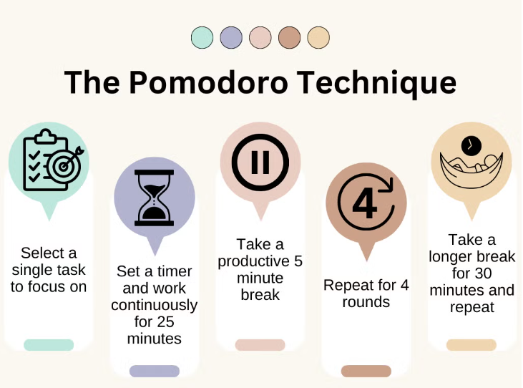

Slide 11
Pomodoro Technique
The Pomodoro Technique is a time management method developed by an Italian Francesco Cirillo in the late 1980s
The basic process of the Pomodoro Technique involves the following steps:
Choose a Task: Select a specific task or project you want to work on. It could be writing an article, coding, studying, or any other activity that requires focus.
Set a Timer for 25 Minutes: Use a timer (traditional kitchen timers, phone apps, or digital tools) to set a countdown for 25 minutes. This time block is called one Pomodoro.
Work on the Task Until the Timer Rings: Focus entirely on the task during this time. Do not allow distractions to interfere with your work. If you think of something else, jot it down and return to your task.
Take a Short Break: When the 25 minutes are up, take a 5-minute break. Stand up, stretch, get some fresh air, or grab a drink. This break helps refresh your mind and body.
Repeat the Cycle: After four Pomodoros (four 25-minute sessions), take a longer break, typically 15 to 30 minutes. This longer break gives you more time to recharge before starting the next cycle.

Slide 12
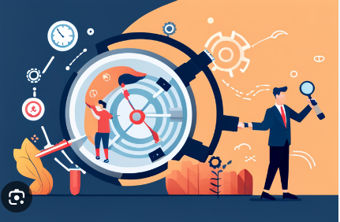
Challenges of Monitoring Time
Over-Monitoring: Excessive tracking of every minute can lead to micromanagement and unnecessary stress.
Inaccuracy: If time logs or tracking apps are not updated in real-time, they can become inaccurate, especially if time gaps are forgotten.
Resistance to Change: Some individuals might resist monitoring their time because they see it as a cumbersome task, but with regular practice, it becomes a habit.

Slide 13
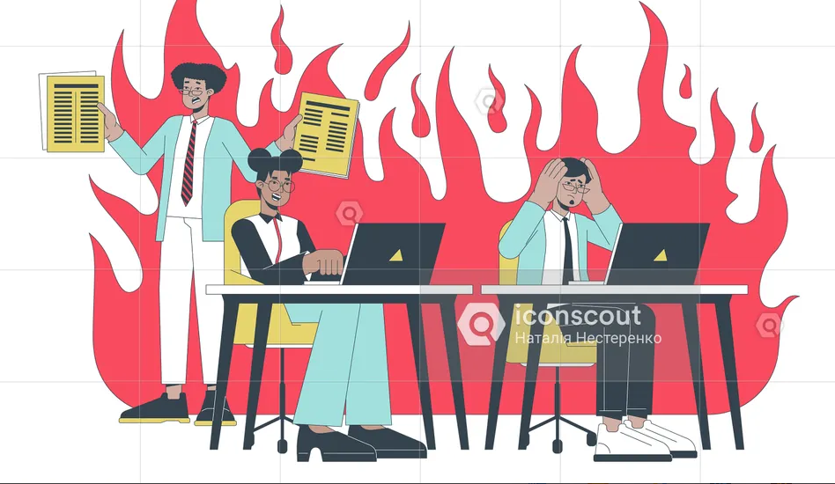
WORKING UNDER PRESSURE

Slide 14

Working Under Pressure – Definition and Challenges
Working under pressure in time management refers to the ability to remain focused, productive, and efficient when faced with tight deadlines, high workloads, or unexpected challenges. It requires managing stress effectively while maintaining high performance, especially in situations where time is limited and the demands are high

Slide 15
Sources of Pressure
Tight Deadlines: When tasks must be completed within a limited time frame, pressure mounts, especially if the task requires a lot of effort.
High Volume of Work: Juggling multiple tasks and responsibilities can create pressure, as there’s often not enough time to focus deeply on any one task.
Unexpected Challenges: Crises such as technical failures, customer complaints, or unforeseen project complications can add to the pressure to complete tasks quickly.
External Expectations: Pressure may come from external factors like clients, supervisors, or team members, who demand quick results or high-quality work.

Slide 16

Challenges of Working Under Pressure
Burnout: Constant pressure without proper stress management can lead to burnout, which affects both productivity and health.
Decreased Quality: In some cases, the pressure to finish tasks quickly can lead to mistakes, oversights, or subpar work.
Emotional Stress: Prolonged exposure to pressure can lead to feelings of anxiety or frustration, which, in turn, impact work quality and personal well-being.

Slide 17
Strategies to Handle Pressure Effectively
Prioritization
Identify Critical Tasks: Under pressure, it is crucial to focus on the most important tasks first.
Break Tasks down into smaller, manageable steps can make them feel more achievable, allowing you to tackle them one at a time.
Planning and Organization
Create a Detailed Action Plan: Organize your tasks by creating a clear timeline of what needs to be done and when.
Use Time-Blocking: Set aside specific chunks of time for each task and stick to them.
One Task at a Time: Multitasking often leads to errors and stress under pressure. Instead, focus on completing one task at a time. This helps maintain a high level of quality and prevents confusion

Slide 18
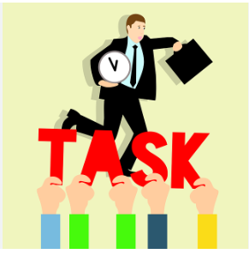
Strategies to Handle Pressure Effectively
Delegate Low-Priority Tasks: When pressure builds, it’s important to focus on tasks that require your attention and expertise. Delegate less critical tasks to others when possible, freeing up your time to handle the most important ones.
Use Short Breaks to Avoid Burnout: Under pressure, it’s easy to forget to take breaks. However, even under tight deadlines, short breaks (like those in the Pomodoro Technique) can help recharge your energy and improve focus when you return to the task.

Slide 19
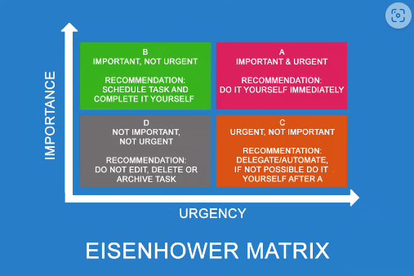
How to Set Priorities-The Eisenhower Matrix

Slide 20
The Eisenhower Matrix
The method is named after Dwight D. Eisenhower, the 34th US president (1953 – 1961). In a speech to the World Council of Churches on 19 August 1954, he quoted a former college president, not mentioned by name, as follows
“I have two kinds of problems, the urgent and the important. The urgent are not important, and the important are never urgent”.¹
Quadrant 1: Urgent and Important (Do First)-Prioritize and complete these tasks immediately.
Quadrant 2: Important but Not Urgent (Schedule)-Schedule these tasks for a later time or in regular intervals. Focus on them to prevent them from becoming urgent.
Quadrant 3: Urgent but Not Important (Delegate) -Delegate these tasks to someone else, or minimize the time spent on them.
Quadrant 4: Neither Urgent nor Important (Eliminate) -Eliminate or drastically reduce these activities to free up time for more important tasks.

Slide 21
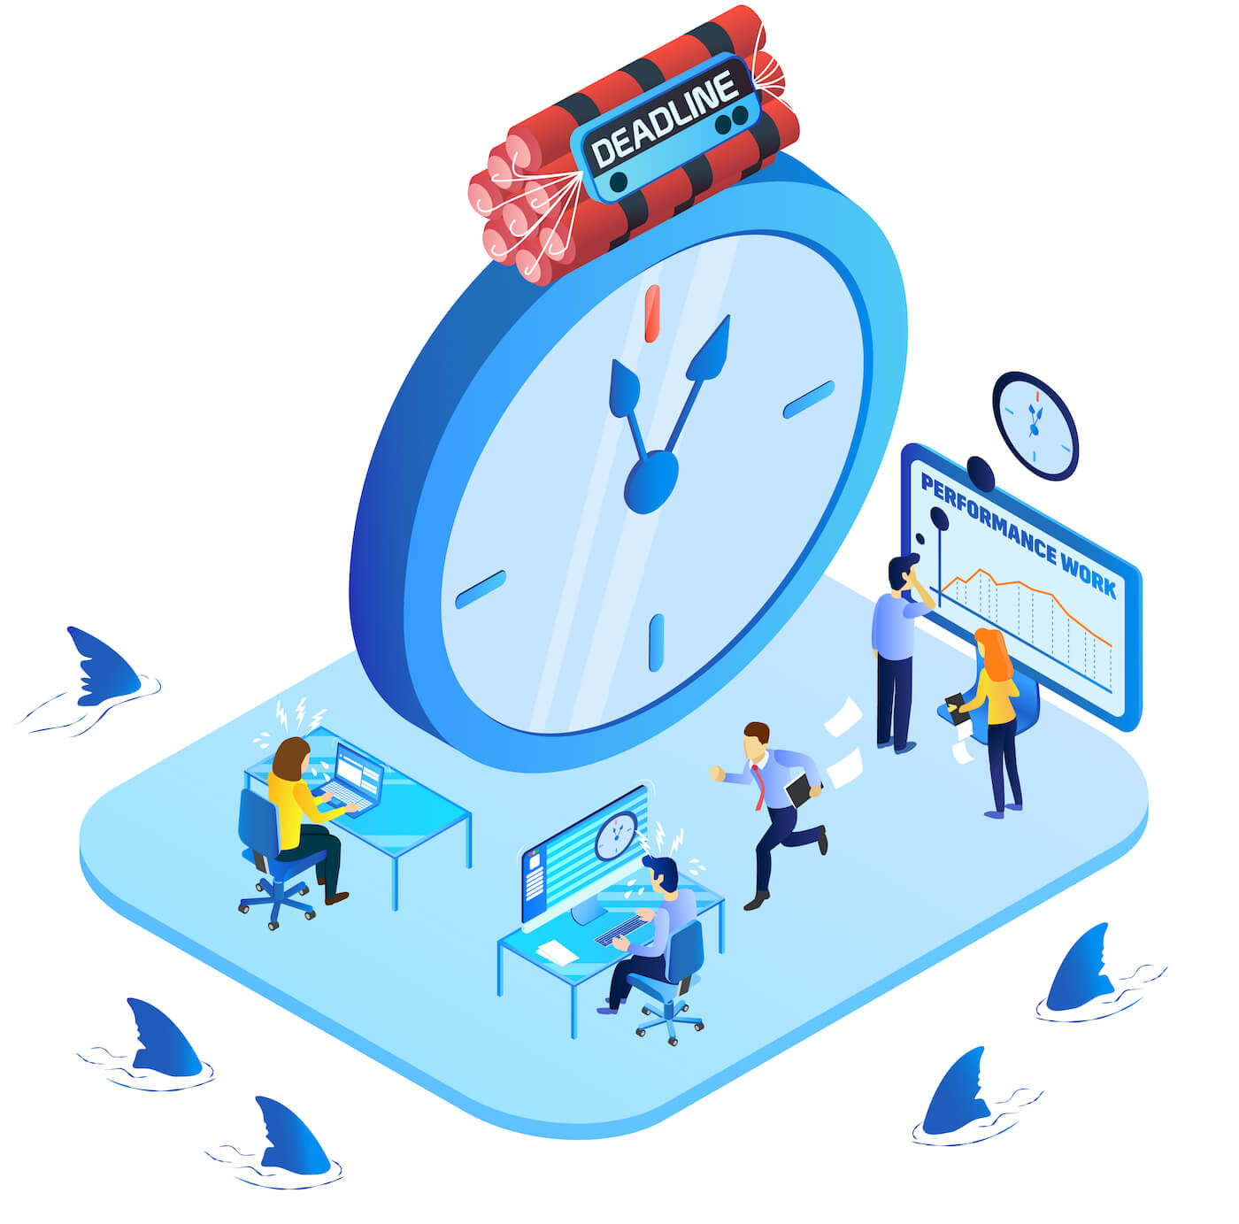
ADHERING TO DEADLINES

Slide 22

What Are Deadlines and Why Are They Important?
Adhering to deadlines in time management refers to the ability to complete tasks, projects, or assignments within the set or agreed-upon time frame.
Meeting deadlines is crucial in both personal and professional contexts as it reflects an individual’s reliability, discipline, and ability to manage their time effectively. It ensures that work progresses as planned and that goals are achieved without delays.

Slide 23
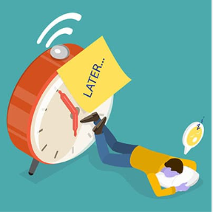
Common Challenges in Adhering to Deadlines
Procrastination: Putting off tasks until the last minute makes it difficult to meet deadlines. This often results in rushed work and lower quality.
Poor Estimation: Underestimating how long a task will take is a common reason for missed deadlines. This often leads to delays and stress as the deadline approaches.
Multitasking: Trying to juggle multiple projects or tasks simultaneously can lead to inefficiency, causing delays in completing any of the tasks.
Unforeseen Circumstances: Unexpected issues such as technical problems, personal emergencies, or additional workload can disrupt plans and make it harder to meet deadlines.

Slide 24

Strategies for Adhering to Deadlines
Understand the Task: Before committing to a deadline, fully understand the task’s scope and the steps required to complete it. This allows for a more accurate estimate of how much time is needed.
Create a Schedule: Use calendars, planners, or time-management tools to create a detailed timeline for completing each task. This schedule should include start dates, intermediate milestones, and final deadlines.

Slide 25
Strategies for Adhering to Deadlines
Focus on Urgent and Important Tasks: Use time management tools like the Eisenhower Matrix to distinguish between urgent, important, and non-essential tasks. Focus on tasks that have the highest priority to ensure you meet critical deadlines.
Adjust Plans if Needed: If you notice that progress is slower than expected, adjust your schedule or re-prioritize tasks. Sometimes, it may be necessary to delegate tasks or request additional help to stay on track.

Slide 26

Combining Time Management, Pressure, and Deadlines for Success
Managing time well helps reduce pressure and ensures deadlines are met. Effective monitoring ensures tasks are on track, and knowing how to handle pressure leads to a more productive, less stressful work environment.
Set SMART Deadlines: Ensure that deadlines are Specific, Measurable, Achievable, Relevant, and Time-bound (SMART) to make them realistic and motivating.
Ask for Help When Necessary: If you feel you won’t be able to meet a deadline, communicate early and ask for assistance rather than waiting until the last minute.
Communicate Effectively: Early communication allows for adjustments or accommodations before the deadline is missed.

Slide 27
THANK YOU

Slide 28
What is the primary purpose of the Presentation?
To entertain the audience
To inform, persuade, or inspire the audience
To fill time
To showcase visual Aids
Notes:
b

Slide 29
How can a Presenter leave a lasting impression at the end of a Presentation?
By using a memorable quote or call to action
By quickly ending the presentation
By listing every point again
By thanking the audience repeatedly
Notes:
a

Slide 30
What is a common mistake people make when prioritizing tasks?
Focusing only on urgent tasks while neglecting important ones
Delegating non essential data
Scheduling time for important tasks
Breaking large tasks into smaller ones
Notes:
a

Slide 31
Which of the following is NOT a benefit of effective time Monitoring?
Identifying bottlenecks in your workflow
Providing data to improve future time management
Increasing stress by micromanaging tasks
Helping to stay on track with deadlines
Notes:
c

Slide 32
Why it is important to take breaks even when working under pressure?
To delay completing tasks
To lose focus on the task
To forget about deadlines
To prevent burnout and maintain high performance
Notes:
d

Slide 33
When you have several tasks to complete, how should you determine which to do first?
Choose the easiest task first
Start with the task that you enjoy the most
Work on all tasks simultaneously
Choose the task that has the closest deadline and the greatest impact
Notes:
d

Slide 34
Time management is an essential skill for people who want to be more
Efficient
Dramatic
Excited
Idiotic
Notes:
a

Slide 35
Which time management technique helps in handling larger projects by breaking them into smaller more manageable parts?
Time Blocking
Chunking
Prioritization
Delegation
Notes:
b

Slide 36
How does setting deadlines help combat procrastination?
It increases stress and pressure
It provides a clear time frame and encourages focus
It causes task avoidance
It reduces accountability
Notes:
Ans: b

Slide 37
What is the most important aspect of an effective schedule?
Flexibility
Filling every hour with task
Leaving no room for change
Scheduling the least important task first
Notes:
Ans: a

Slide 38
Which of the following can negatively affect time management
Prioritizing tasks
Procrastination
Delegating task
Goal setting
Notes:
Ans: b

Slide 39
What mindset is most helpful when working under pressure
Focusing on negative outcomes
Staying calm and solution oriented
Ignoring tasks until the last minute
Avoiding teamwork
Notes:
Ans: b

Slide 40
Why is it important to include buffer time in your schedule?
To allow flexibility for unexpected delay or tasks
To ensure you are constantly working without breaks
To reduce the number of tasks you complete
To extend the length of your workday
Notes:
Ans: a

Slide 41
A single session presentation can be for________
An hour
Three hours
Quarter of an hour
Six hours
Notes:
Ans: a

Slide 42
The objective of the presentation “how to coexist with olive ridleys?” to a group of fishermen can be for ____________purpose.
Provocation
Information
Teaching
stimulation
Notes:
Ans: b

Slide 43
The phrase, “ I therefore suggest the following strategy“ – is ideally used at ____________ stage of the presentation
Intro
Main idea of the presentation
Conclusion
none
Notes:
Ans: c

Slide 44
Creative ideas that are not limited by current thinking or beliefs are also known as____
Red sky thinking
Blue sky thinking
White sky thinking
Purple sky thinking
Notes:
Ans: b

Slide 45
Which among the following is appropriate while presenting a topics?
Read from the PPT only
Carry a small chit for clues and keep glancing at the PPT
Show videos alone
none
Notes:
Ans:

Slide 46
Typical length of an elevator pitch?
10 sec
30sec – 1 min
5 min
10min
Notes:
Ans: b

Slide 47
How can setting mini deadlines within a project helps with time management?
It helps break down the project into manageable parts and maintain momentum
It decreases the overall quality of work
It makes the project more complicated
It leads to procrastination
Notes:
Ans: a

Slide 48
What is a common mistakes people make when trying to meet deadlines?
Planning tasks thoroughly
Overcommitting to too many tasks at once
Delegating task effectively
Breaking tasks into smaller steps
Notes:
Ans: b

Slide 49
What does the Eisenhower Matrix help with?
Organizing tasks by difficulty
Categorizing tasks by urgency and importance
Splitting tasks into small parts
Automating tasks
Notes:
b

Slide 50
Which of the following best describes a complete Pomodaro cycle?
50 minutes work, 10 minutes break
60 minutes work, 15 minutes break
25 minutes work, 5 minutes break
45 minutes work, 15 minutes break
Notes:
c

